Slide 1
Human Computer Interaction
Dialog Notations and Design
Chapter 16b
Imran Siddiqi
imran.siddiqi@gmail.com

Slide 2
Petri Nets
One of the oldest notations in computing!
Flow graph:
    Places – a bit like STN states
    Transitions – a bit like STN arcs
    Counters/Tokens – sit on places (current state)
Dialog Notations and Design

Slide 3
Petri Nets - Basics
Petri net consist two types of nodes: places and transitions. An arc exists only from a place to a transition or from a transition to a place.
A place may have zero or more tokens.
Graphically, places, transitions, arcs, and tokens are represented respectively by: circles, bars, arrows, and dots.
p₁
t₁
p₂
Dialog Notations and Design

Slide 4
Petri Nets - Basics
Below is an example Petri net with two places and one transition.
Transition node is ready to fire if and only if there is at least one token at each of its input places
State transition of form (1, 0) → (0, 1)
P1:Input place - P2:Output place
p₁
t₁
p₂
Dialog Notations and Design

Slide 5
Petri Nets - Properties
Sequential Execution
  Transition t2 can fire only after the firing of t1. This impose the precedence of constraints "t2 after t1.“
p₁
t₁
p₂
t₂
p₃
Dialog Notations and Design

Slide 6
Petri Nets - Properties
Synchronization
  Transition t1 will be enabled only when there is at least one token at each of its input places.
t₁
Merging
  Happens when tokens from several places arrive for service at the same transition.
Dialog Notations and Design

Slide 7
Petri Nets - Properties
Concurrency
  t1 and t2 are concurrent. With this property, Petri net is able to model systems of distributed control with multiple processes executing concurrently in time
t₁
t₂
Dialog Notations and Design

Slide 8
Petri Nets - Properties
Conflict
  t1 and t2 are both ready to fire but the firing of any leads to the disabling of the other transitions.
t₁
t₂
t₁
t₂
Dialog Notations and Design

Slide 9
Petri Nets - Properties
Conflict (Contd…)
  The resulting conflict may be resolved in a purely non-deterministic way or in a probabilistic way, by assigning appropriate probabilities to the conflicting transitions
There is a choice of either t1 and t2, or t3 and t4
t₁
t₂
t₃
t₄
Dialog Notations and Design

Slide 10
Petri Nets - Examples
Dialog Notations and Design

Slide 11
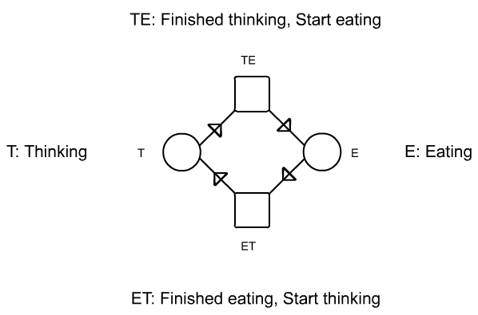
Petri Nets - Philosopher
Model
Dialog Notations and Design

Slide 12
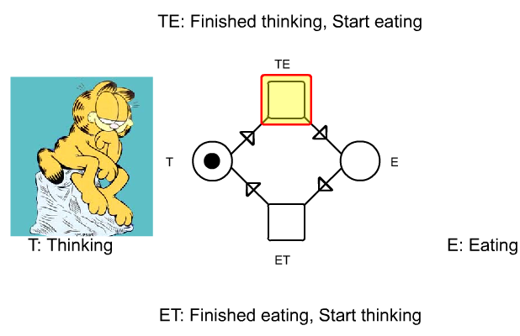
Petri Nets - Philosopher
Dialog Notations and Design

Slide 13
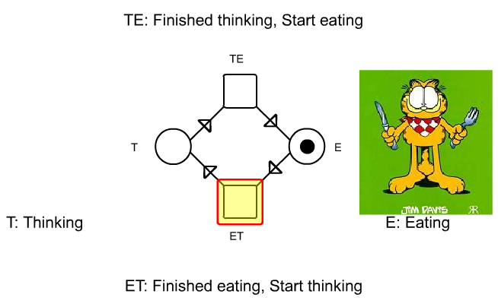
Petri Nets - Philosopher
Dialog Notations and Design

Slide 14
Petri Nets - Philosopher
Dialog Notations and Design

Slide 15
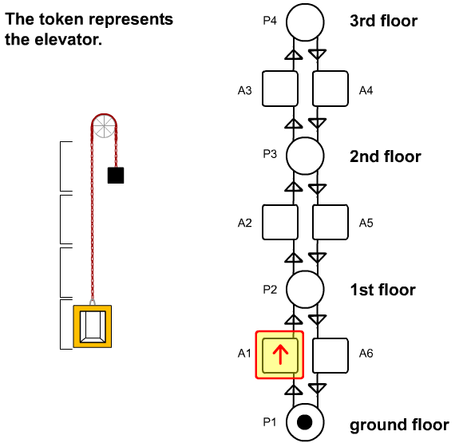
Petri Nets - Elevator
Dialog Notations and Design

Slide 16
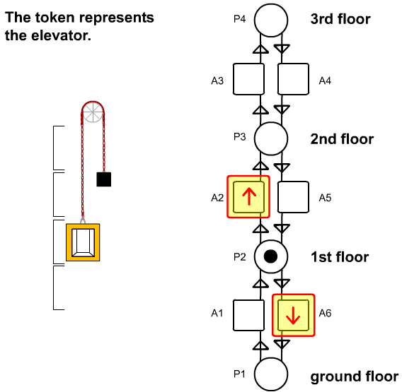
Petri Nets - Elevator
Dialog Notations and Design

Slide 17
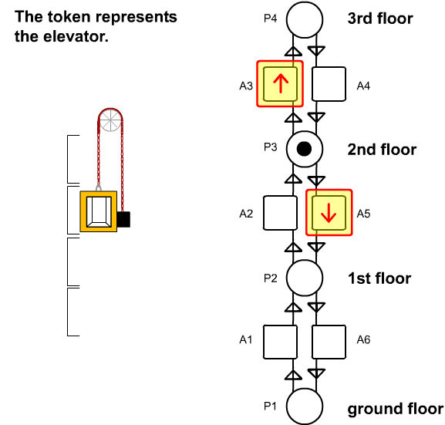
Petri Nets - Elevator
Dialog Notations and Design

Slide 18
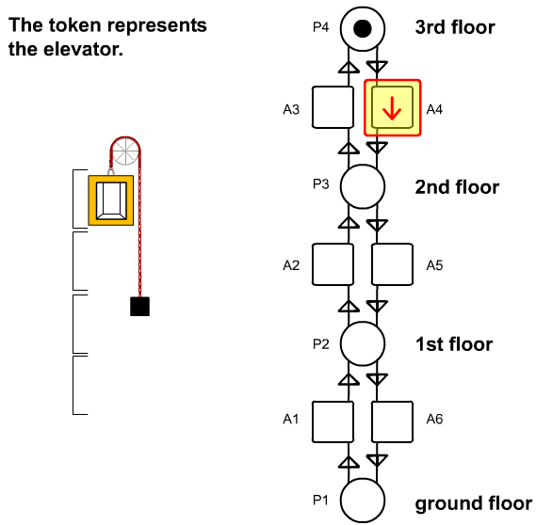
Petri Nets - Elevator
Dialog Notations and Design

Slide 19
Petri Nets – In a Restaurant
Waiter
free
Customer 1
Customer 2
Take
order
Take
order
wait
Order
taken
wait
eating
eating
Tell
kitchen
Serve food
Serve food
Dialog Notations and Design

Slide 20
Petri Nets – In a Restaurant
Scenario 1:
  Waiter takes order from customer 1; serves customer 1; takes order from customer 2; serves customer 2.
Scenario 2:
  Waiter takes order from customer 1; takes order from customer 2; serves customer 2; serves customer 1.
Dialog Notations and Design

Slide 21
Petri Nets – In a Restaurant (Scenario 1)
Waiter
free
Customer 1
Customer 2
Take
order
Take
order
wait
Order
taken
wait
eating
eating
Tell
kitchen
Serve food
Serve food
Dialog Notations and Design

Slide 22
Petri Nets – In a Restaurant (Scenario 2)
Waiter
free
Customer 1
Customer 2
Take
order
Take
order
wait
Order
taken
wait
eating
eating
Tell
kitchen
Serve food
Serve food
Dialog Notations and Design

Slide 23
Petri Nets – Vending Machine
Take 15c bar
Deposit 10c
15c
5c
Deposit 5c
Deposit
5c
Deposit
5c
0c
Deposit
5c
Deposit 10c
10c
20c
Deposit 10c
Take 20c bar
Dialog Notations and Design

Slide 24
Petri Nets – Vending Machine
Scenario 1:
  Deposit 5c, deposit 5c, deposit 5c, deposit 5c, take 20c snack bar.
Scenario 2:
  Deposit 10c, deposit 5c, take 15c snack bar.
Scenario 3:
  Deposit 5c, deposit 10c, deposit 5c, take 20c snack bar.
Dialog Notations and Design

Slide 25
Petri Nets – Vending Machine
Take 15c bar
Deposit 10c
15c
5c
Deposit 5c
Deposit
5c
Deposit
5c
0c
Deposit
5c
Deposit 10c
10c
20c
Deposit 10c
Take 20c bar
Dialog Notations and Design

Slide 26
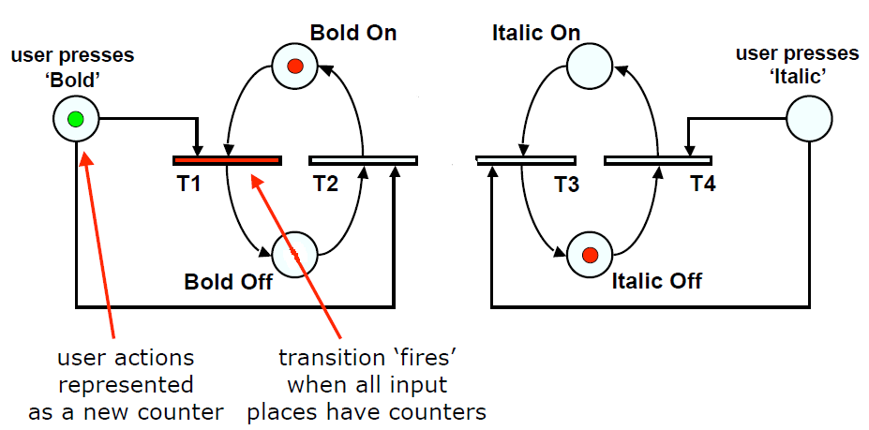
Petri Nets – Bold/Italic
Image Segmentation

Slide 27
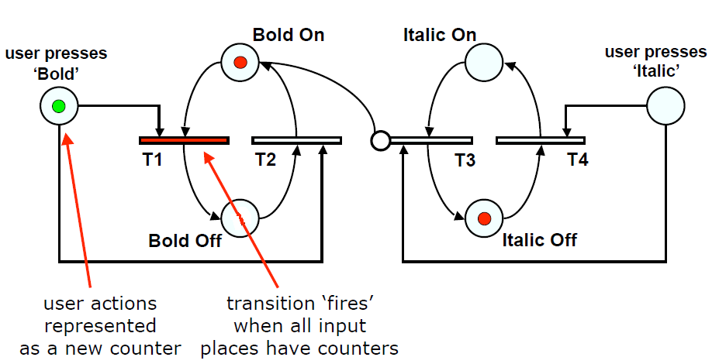
Petri Nets – Bold/Italic
Inhibition – T3 can NOT fire if there is a token in ‘Bold On’
Image Segmentation

Slide 28
State Charts
Used in UML
Extension to STN
Name
State
Start/Initial State
Stop/Final State
Event / Action
Dialog Notations and Design

Slide 29
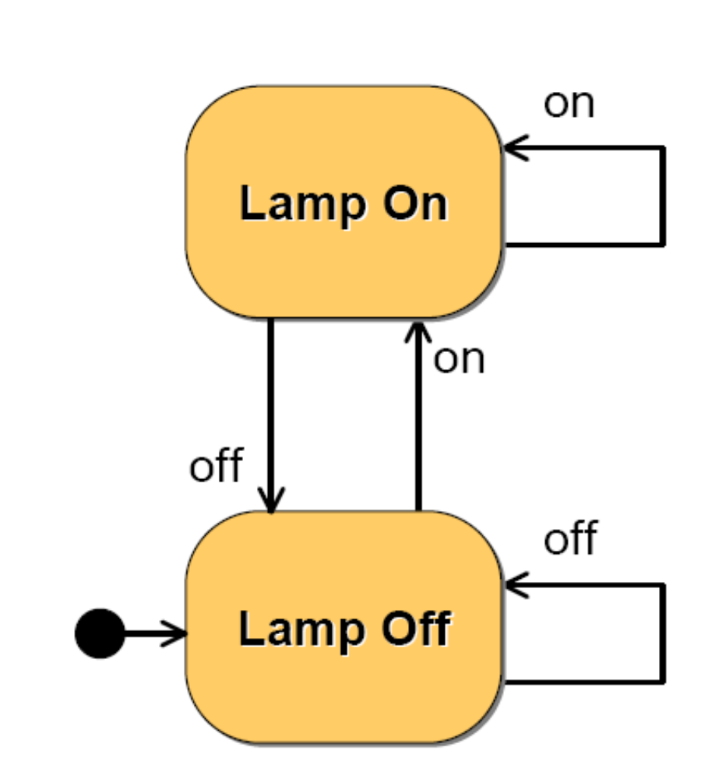
State Charts
Dialog Notations and Design

Slide 30
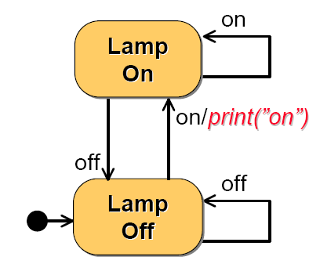
State Charts
Dialog Notations and Design

Slide 31
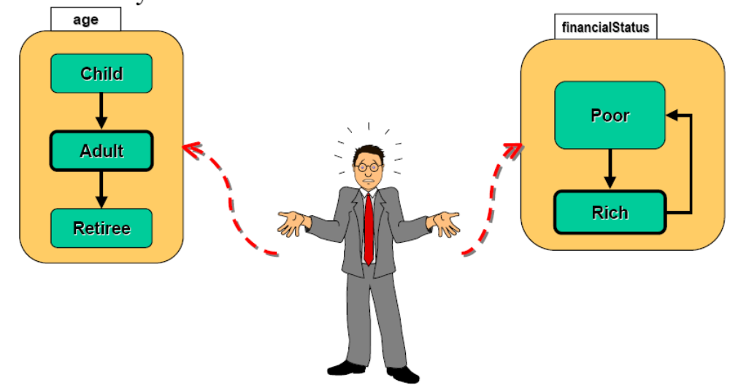
State Charts
Multiple simultaneous perspectives on the same entity
Dialog Notations and Design

Slide 32
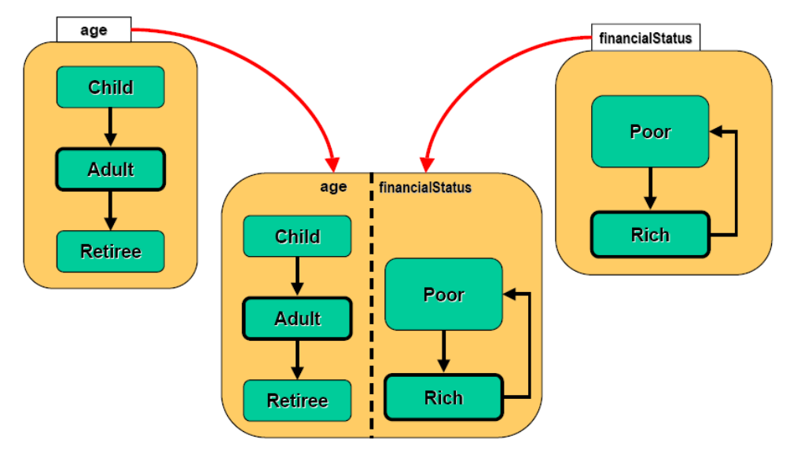
State Charts
Combine multiple simultaneous descriptions
Dialog Notations and Design

Slide 33
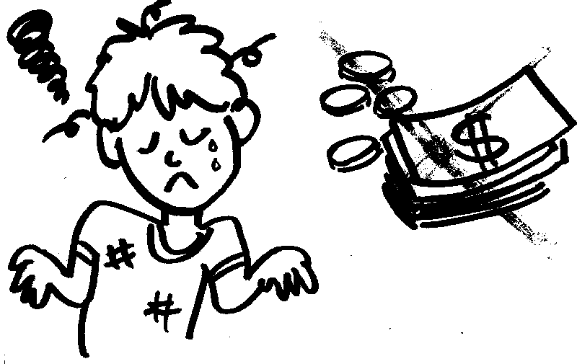

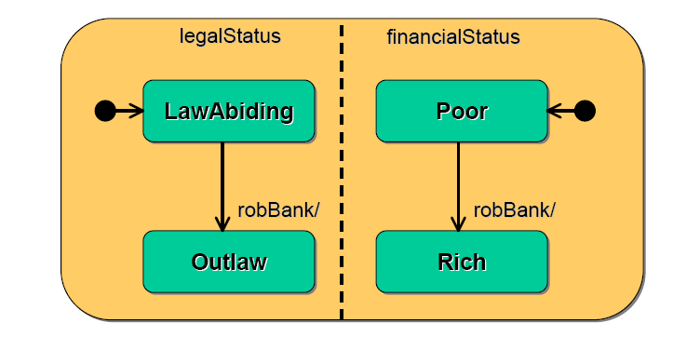

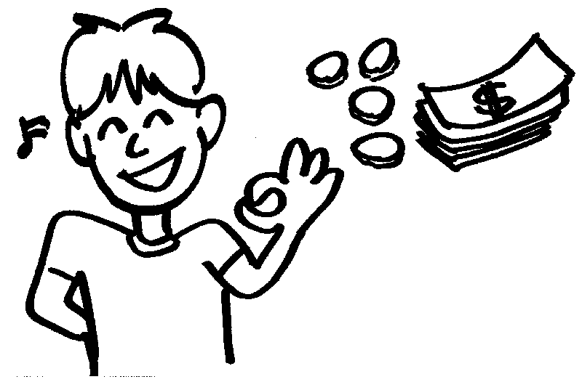
State Charts
Dialog Notations and Design

Slide 34
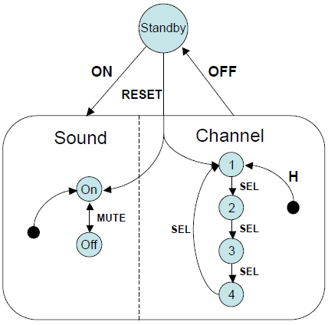
State Charts - Television Set
Concurrent sub-nets
Escapes
  OFF always active
History
  Link marked H goes back to last state on re-entering subdialogue
Image Segmentation

Slide 35
Flow Charts
Delete
Please enter
employee no.: ____
Screens
Familiar to programmers
Used for Dialog
Not internal algorithm
Database Access
read record
Delete
Delete
Name: Alan Dix
Dept: Computing
delete? (Y/N): _
Name: Alan Dix
Dept: Computing
delete? (Y/N): _
Please enter Y or N
other
answer?
Y
N
Finish
delete record
Process/Decision
Finish
Dialog Notations and Design

Slide 36
JSD Diagrams
JSD – Jackson Structured Design
Similar to Hierarchical Task Analysis
Personnel
Record
System
login
transaction
*
logout
add
employee
record
change
employee
record
display
employee
record
delete
employee
record
Dialog Notations and Design

Slide 37
JSD Diagrams
Personnel
Record
System
Sequence – Left to Right
login
transaction
*
logout
add
employee
record
change
employee
record
display
employee
record
delete
employee
record
Can not do any transactions before login
‘o’ – Optional elements
  Transaction may be anyone of the four operations
‘*’ – Iterations: Any number of repetitions
  Login – Any number of transactions - Logout
Dialog Notations and Design

Slide 38
Dangerous States
Word processor: two modes and exit
    F1 - changes mode
    F2 - exit (and save)
    Esc - no mode change
  but ... Esc resets autosave
Esc
edit
F1
menu
F2
exit
Dialog Notations and Design

Slide 39
Dangerous States
Exit without save ⇒ dangerous state
Duplicate states - semantic distinction
F1-F2 - exit with save
F1-Esc-F2 - exit with no save
edit
F1
menu
F2
exit
any
update
Esc
edit
F1
menu
F2
exit
Esc
Dialog Notations and Design

Slide 40
Dangerous States and Key Layout
Word processor - dangerous states
Old keyboard - OK
edit
F1
menu
F2
exit
any
update
Esc
edit
F1
menu
F2
exit
Esc
1
Esc
tab
...
F1
F2
...
F3
F4
...
...
Dialog Notations and Design

Slide 41
Dangerous States and Key Layout
New keyboard layout
intend F1-F2 (save)
finger catches Esc
...
Esc
F1
F2
F3
edit
F1
menu
F2
exit
any
update
Esc
edit
F1
menu
F2
exit
Esc
Dialog Notations and Design

Slide 42
Dangerous States and Key Layout
New keyboard layout
intend F1-F2 (save)
finger catches Esc
F1-Esc-F2 - disaster!
...
Esc
F1
F2
F3
edit
F1
menu
F2
exit
any
update
Esc
edit
F1
menu
F2
exit
Esc
Dialog Notations and Design

Slide 43
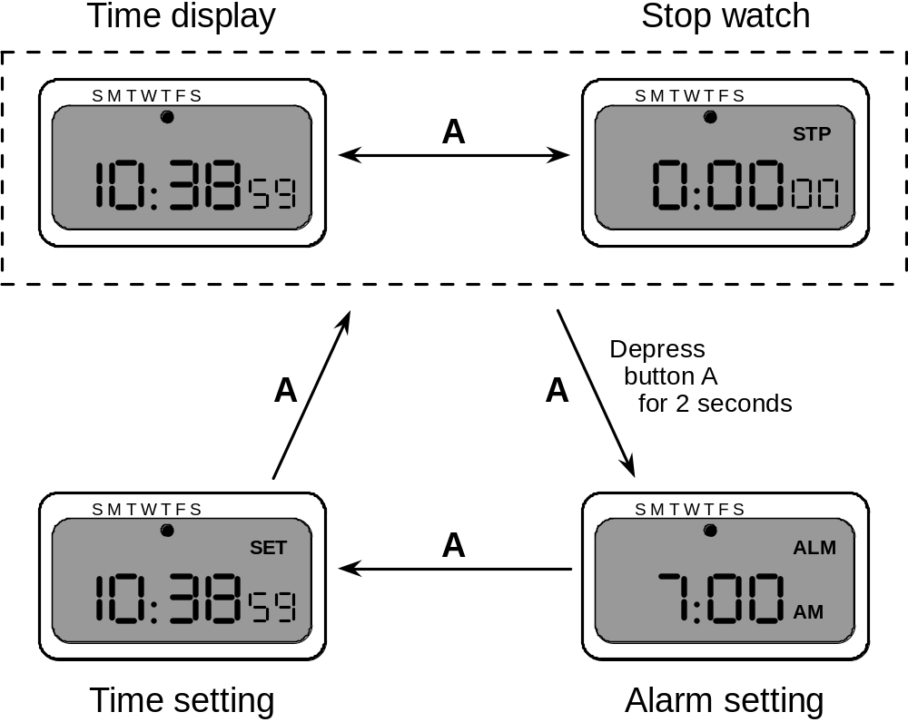
Digital Watch – User Instructions
Different modes
Limited interface
- 3 buttons
Button A
changes mode
Dialog Notations and Design

Slide 44
Digital Watch – User Instructions
Dangerous states
  Guarded
  … by two second hold
Completeness
  Distinguish depress A
  and release A
  What do they do
  in all modes?
Dialog Notations and Design

Slide 45
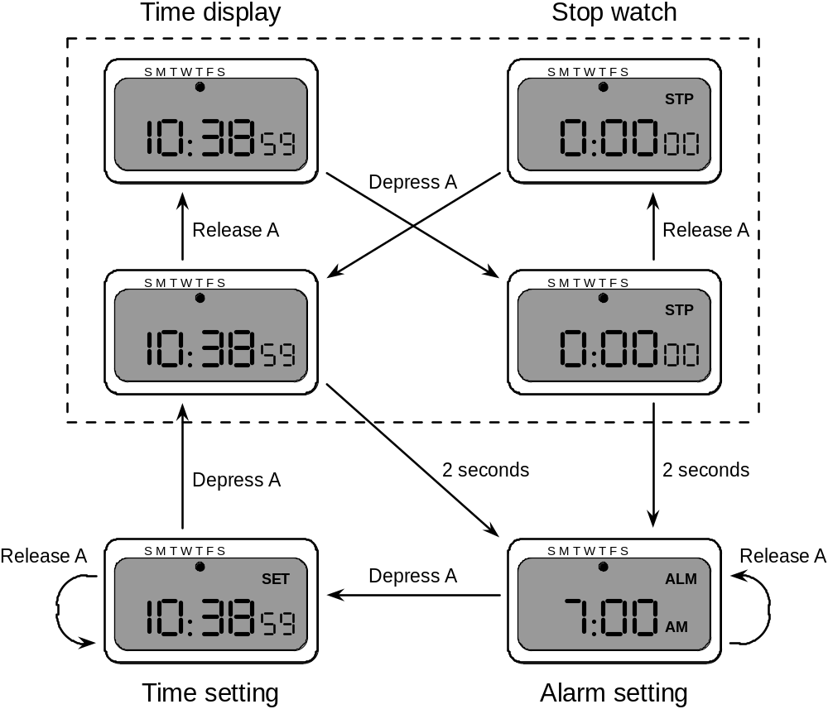
Digital Watch – Designer Instructions
and ...
that’s just
one button
Dialog Notations and Design

Slide 46

References
Chapter 16 - Human Computer Interaction by Dix et al.
Interactive Tutorials on Petri Nets, Wil van der Aalst, et al. TU Eindhoven, Netherlands
Modeling and Simulation, P. Fishwick
Dialog Notations and Design

